Slide 1
Distributed Systems
Consistency and Replication
Chapter 7

Slide 2
Course/Slides Credits
Note: all course presentations are based on those developed by Andrew S. Tanenbaum and Maarten van Steen. They accompany their "Distributed Systems: Principles and Paradigms" textbook (1st & 2nd editions).
http://www.prenhall.com/divisions/esm/app/author_tanenbaum/custom/dist_sys_1e/index.html
And additions made by Paul Barry in course CW046-4: Distributed Systems
http://glasnost.itcarlow.ie/~barryp/net4.html

Slide 3
Reasons for Replication
Data are replicated to increase the reliability of a system.
Replication for performance:
  Scaling in numbers
  Scaling in geographical area
Caveat:
  Gain in performance
  Cost of increased bandwidth for maintaining replication

Slide 4
More on Replication
Replicas allows remote sites to continue working in the event of local failures.
It is also possible to protect against data corruption.
Replicas allow data to reside close to where
it is used.
Even a large number of replicated “local” systems can improve performance: think of clusters.
This directly supports the distributed systems goal
of enhanced scalability.

Slide 5
Replication and Scalability
Replication is a widely-used scalability technique: think of
Web clients and Web proxies.
When systems scale, the first problems to surface are those associated with performance – as the systems get bigger
(e.g., more users), they get often slower.
Replicating the data and moving it closer to where it is needed helps to solve this scalability problem.
A problem remains: how to efficiently synchronize all of
the replicas created to solve the scalability issue?
Dilemma: adding replicas improves scalability, but incurs
the (oftentimes considerable) overhead of keeping the replicas up-to-date!!!
As we shall see, the solution often results in a relaxation of any consistency constraints.

Slide 6
Replication and Consistency
But if there are many replicas of the same thing, how do we keep all of them up-to-date? How do we keep the replicas consistent?
Consistency can be achieved in a number of ways. We will study a number of consistency models, as well as protocols for implementing the models.
So, what’s the catch?
  It is not easy to keep all those replicas consistent.

Slide 7
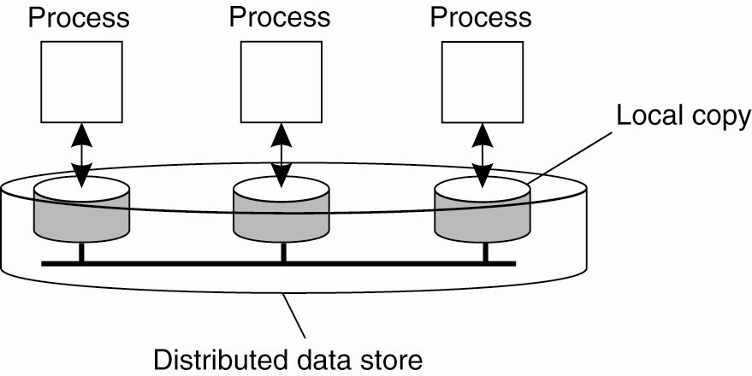
Data-centric Consistency Models
The general organization of a logical data store, physically distributed and replicated across multiple processes

Slide 8
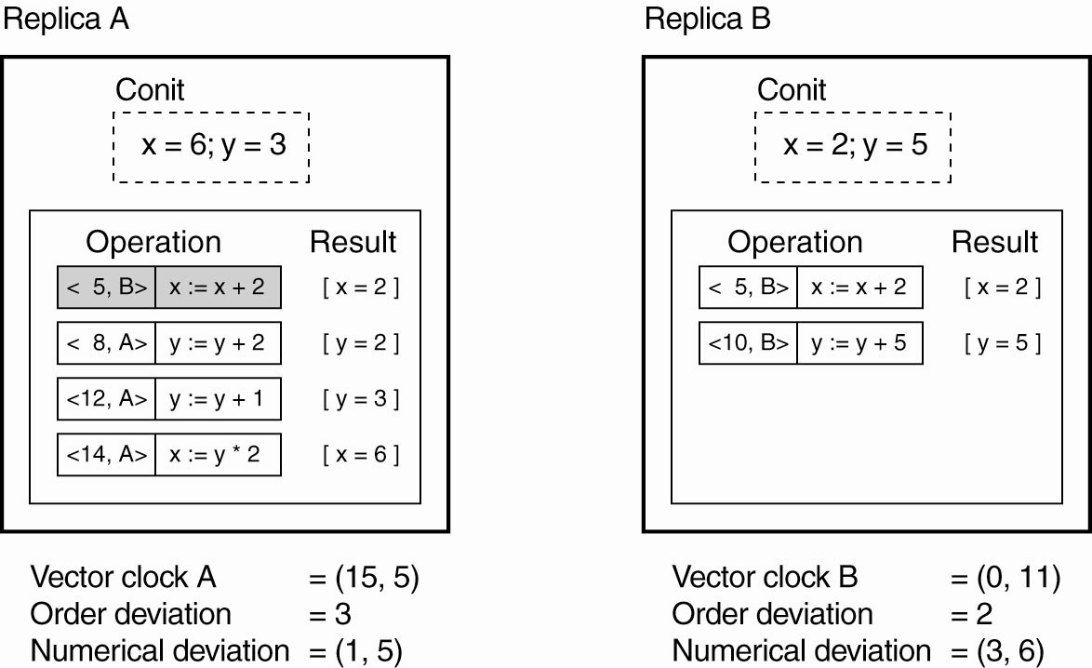
Continuous Consistency (1)
An example of keeping track of consistency
deviations [adapted from (Yu and Vahdat, 2002)]

Slide 9
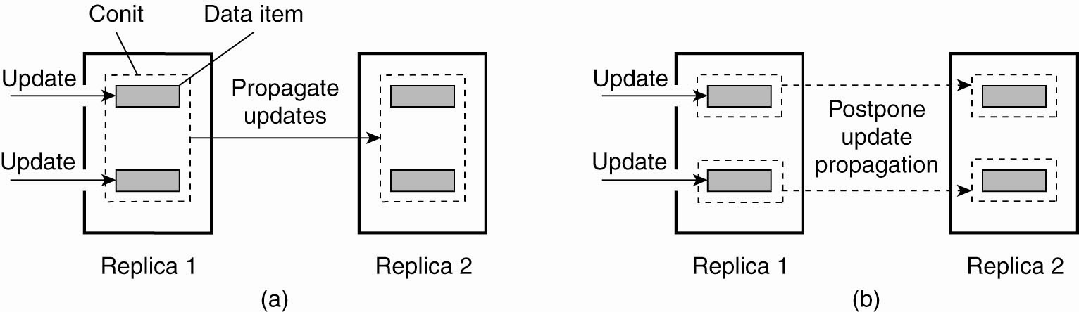
Continuous Consistency (2)
Choosing the appropriate granularity for a Conit.
(a) Two updates lead to update propagation.

Slide 10
Continuous Consistency (3)
Choosing the appropriate granularity for a Conit.
(b) No update propagation is needed (yet).

Slide 11
What is a Consistency Model?
A “consistency model” is a CONTRACT between a DS data-store and its processes.
If the processes agree to the rules, the
data-store will perform properly and as advertised.
We start with Strict Consistency, which is defined as:
  Any read on a data item ‘x’ returns a value corresponding to the result of the most recent write on ‘x’ (regardless of where the write occurred).

Slide 12
Consistency Model Diagram Notation
W_{i}(x)a – a write by process ‘i’ to item ‘x’ with a value of ‘a’. That is, ‘x’ is set to ‘a’.
(Note: The process is often shown as ‘P_{i}’).
R_{i}(x)b – a read by process ‘i’ from item ‘x’ producing the value ‘b’. That is, reading ‘x’ returns ‘b’.
Time moves from left to right in all diagrams.

Slide 13

Strict Consistency
Behavior of two processes, operating on same data item:
  A strictly consistent data-store.
  A data-store that is not strictly consistent.
With Strict Consistency, all writes are instantaneously visible to all processes and absolute global time order is maintained throughout the DS. This is the consistency model “Holy Grail” – not at all easy in the real world, and all but impossible within a DS. So, other, less strict (or “weaker”) models have been developed …

Slide 14
Sequential Consistency (1)
A weaker consistency model, which represents a relaxation of the rules.
It is also much easier (possible) to implement.
Definition of “Sequential Consistency”:
  The result of any execution is the same as if the (read and write) operations by all processes on the data-store were executed in the same sequential order and the operations of each individual process appear in this sequence in the order specified by its program.

Slide 15
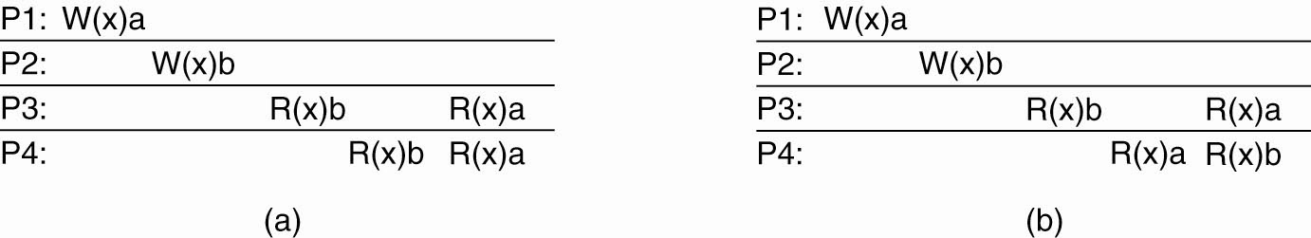
Sequential Consistency (2)
(a) A sequentially consistent data store.
(b) A data store that is not sequentially consistent.

Slide 16
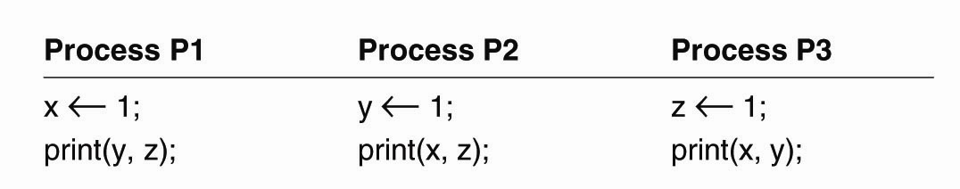
Sequential Consistency (3)
Three concurrently-executing processes

Slide 17
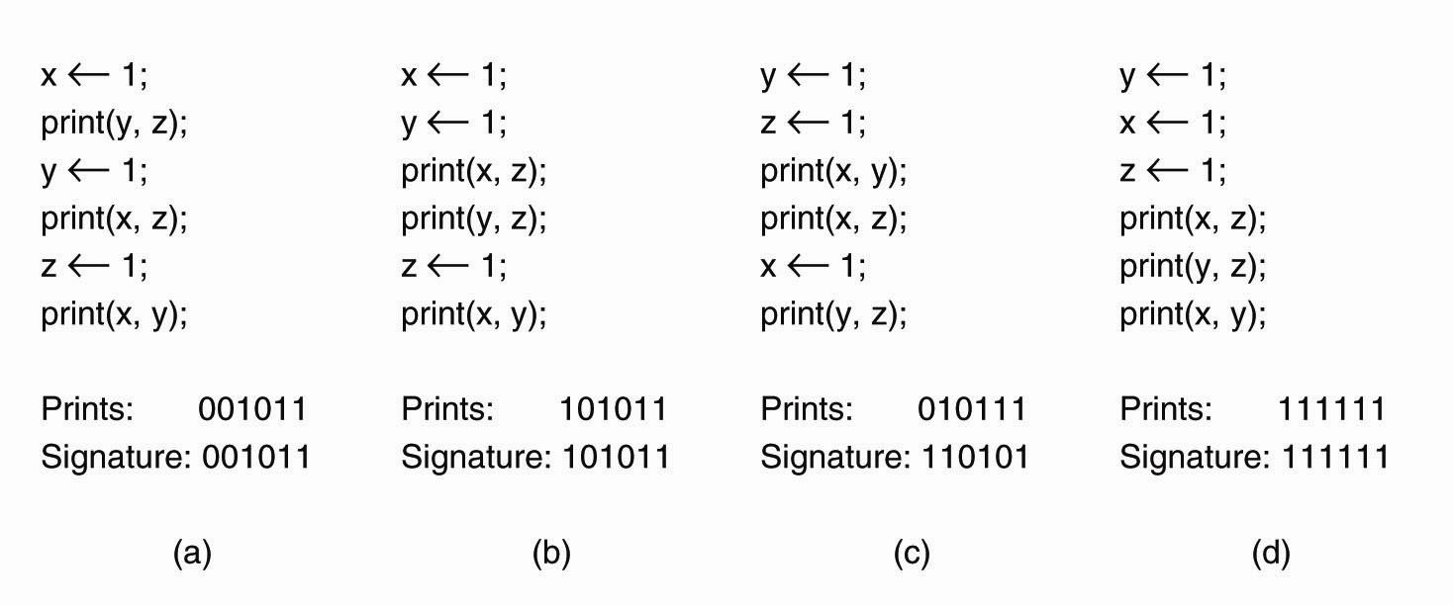
Sequential Consistency (4)
Four valid execution sequences for these processes. The vertical axis is time.

Slide 18
Problem with Sequential Consistency
With this consistency model, adjusting the protocol to favor reads over writes (or vice-versa) can have a devastating impact on performance (refer to the textbook for the gory details).
For this reason, other weaker consistency models have been proposed and developed.
Again, a relaxation of the rules allows for these weaker models to make sense.

Slide 19
Causal Consistency
This model distinguishes between events that are “causally related” and those that are not.
If event B is caused or influenced by an earlier event A, then causal consistency requires that every other process see event A, then event B.
Operations that are not causally related are said to be concurrent.

Slide 20
Causal Consistency (1)
For a data store to be considered causally consistent, it is necessary that the store
obeys the following conditions:
  Writes that are potentially causally related
    must be seen by all processes in the same order.
  Concurrent writes
    may be seen in a different order on different machines.

Slide 21
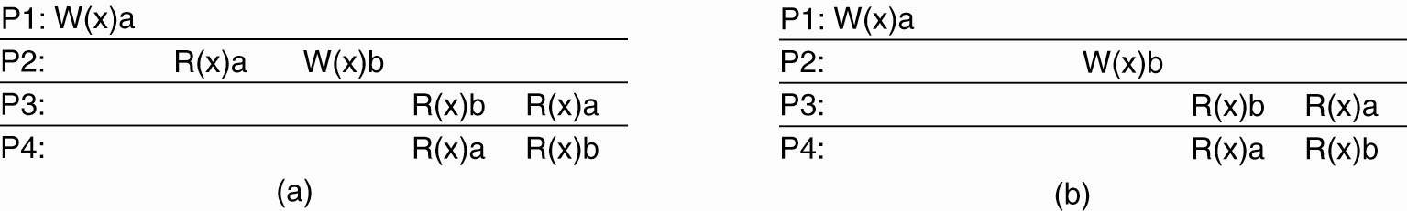
Causal Consistency (2)
(a) A violation of a causally-consistent store

Slide 22
Causal Consistency (3)
(b) A correct sequence of events in
a causally-consistent store

Slide 23
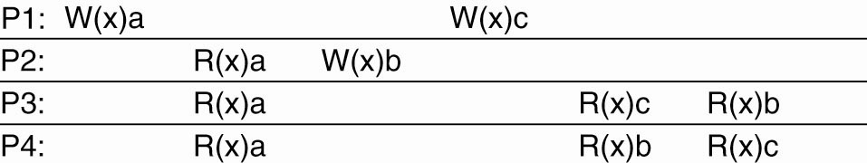
Causal Consistency (4)
This sequence is allowed with a
causally-consistent store, but not with a sequentially consistent store

Slide 24
Introducing Weak Consistency
Not all applications need to see all writes, let alone seeing them in the same order.
This leads to “Weak Consistency” (which is primarily designed to work with distributed critical sections).
This model introduces the notion of a “synchronization variable”, which is used to update all copies of the data-store.

Slide 25
Weak Consistency Properties
The three properties of Weak Consistency:
Accesses to synchronization variables associated with a data-store are sequentially consistent.
No operation on a synchronization variable is allowed to be performed until all previous writes have been completed everywhere.
No read or write operation on data items are allowed to be performed until all previous operations to synchronization variables have been performed.

Slide 26
Weak Consistency: What It Means
So …
By doing a sync., a process can force the just written value out to all the other replicas.
Also, by doing a sync., a process can be sure it’s getting the most recently written value before it reads.
In essence, the weak consistency models enforce consistency on a group of operations, as opposed to individual reads and writes (as is the case with strict, sequential, causal and FIFO consistency).

Slide 27
Grouping Operations
Necessary criteria for correct synchronization:
An acquire access of a synchronization variable, not allowed to perform until all updates to guarded shared data have been performed with respect to that process.
Before exclusive mode access to synchronization variable by process is allowed to perform with respect to that process, no other process may hold synchronization variable, not even in nonexclusive mode.
After exclusive mode access to synchronization variable has been performed, any other process’ next nonexclusive mode access to that synchronization variable may not be performed until it has performed with respect to that variable’s owner.

Slide 28

Entry Consistency
At an acquire, all remote changes to guarded data must be brought up to date.
Before a write to a data item, a process must ensure that no other process is trying to write at same time.
Locks associate with individual data items, as opposed to the entire data-store. Note: P2’s read on ‘y’ returns NIL as no locks have been requested.

Slide 29
Client-Centric Consistency Models
The previously studied consistency models concern themselves with maintaining a consistent (globally accessible) data-store in the presence of concurrent read/write operations
Another class of distributed data-store is that which is characterized by the lack of simultaneous updates. Here, the emphasis is more on maintaining a consistent view of things for the individual client process that is currently operating on the data-store.

Slide 30
More Client-Centric Consistency
How fast should updates (writes) be made available to read-only processes?
  Think of most database systems: mainly read.
  Think of the DNS: write-write conflicts do no occur, only read-write conflicts.
  Think of WWW: as with DNS, except that heavy use of client-side caching is present: even the
  return of stale pages is acceptable to most users.
These systems all exhibit a high degree of acceptable inconsistency … with the replicas gradually becoming consistent over time.

Slide 31
Toward Eventual Consistency
The only requirement is that all replicas will eventually be the same.
All updates must be guaranteed to propagate to all replicas … eventually!
This works well if every client always updates the same replica.
Things are a little difficult if the clients are mobile.

Slide 32
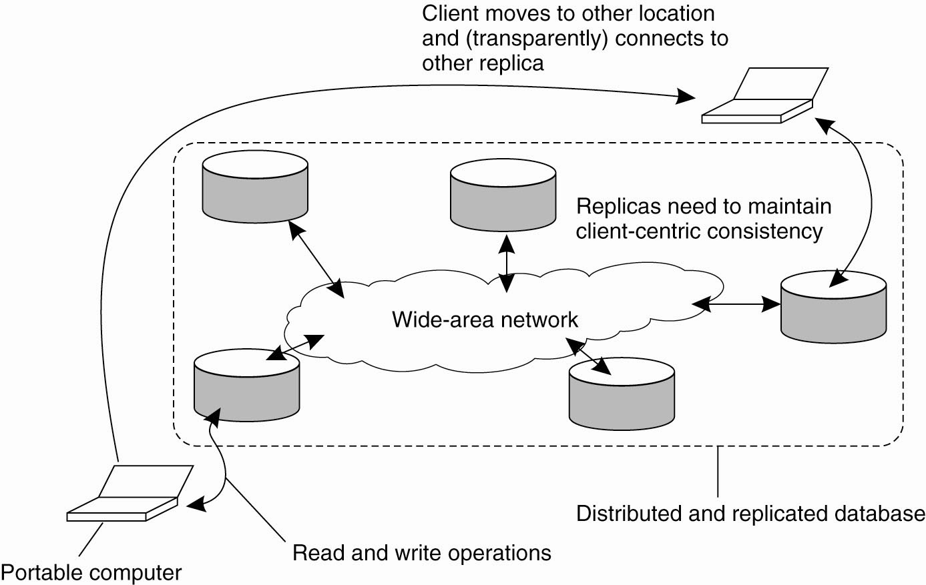
Eventual Consistency
The principle of a mobile user accessing
different replicas of a distributed database

Slide 33
Monotonic Reads (1)
A data store is said to provide monotonic-read consistency if the following condition holds:
  If a process reads the value of a data item x
    any successive read operation on x by that process will always return that same value or a more recent value.

Slide 34
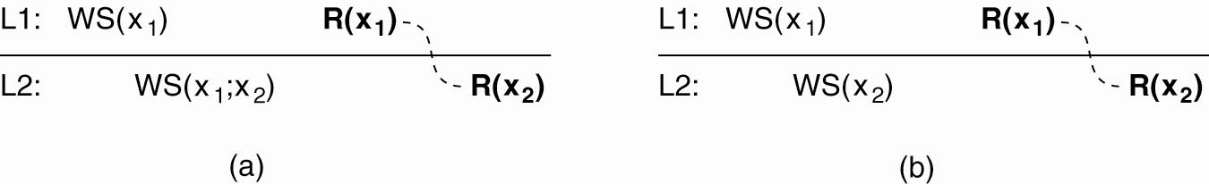
Monotonic Reads (2)
The read operations performed by a single process P at two different local copies of the same data store.
(a) A monotonic-read consistent data store.

Slide 35
Monotonic Reads (3)
The read operations performed by a single process P at two different local copies of the same data store.
(b) A data store that does not provide monotonic reads.

Slide 36
Monotonic Writes (1)
In a monotonic-write consistent store, the following condition holds:
  A write operation by a process on a data item x
    is completed before any successive write operation on x by the same process.

Slide 37
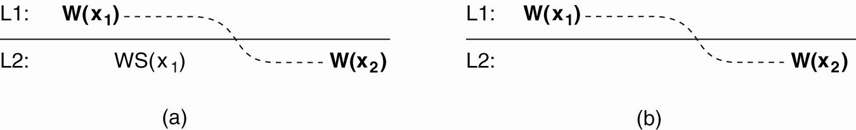
Monotonic Writes (2)
The write operations performed by a single process P at two different local copies of the same data store.
(a) A monotonic-write consistent data store.

Slide 38
Monotonic Writes (3)
The write operations performed by a single process P at two different local copies of the same data store. (b) A data store that does not provide monotonic-write consistency.

Slide 39
Read Your Writes (1)
A data store is said to provide
read-your-writes consistency, if the following condition holds:
  The effect of a write operation by a process on data item x
    will always be seen by a successive read operation on x by the same process.

Slide 40
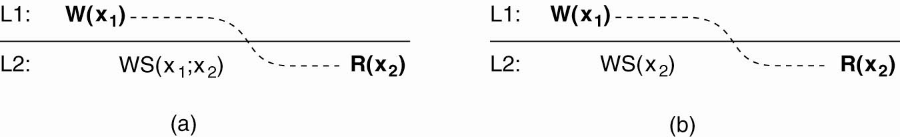
Read Your Writes (2)
(a) A data store that provides
read-your-writes consistency

Slide 41
Read Your Writes (3)
(b) A data store that does not

Slide 42
Writes Follow Reads (1)
A data store is said to provide
writes-follow-reads consistency,
if the following holds:
  A write operation by a process
    on a data item x following a previous read operation on x by the same process is guaranteed to take place on the same or a more recent value of x that was read.

Slide 43

Writes Follow Reads (2)
(a) A writes-follow-reads consistent data store

Slide 44
Writes Follow Reads (3)
(b) A data store that does not provide
writes-follow-reads consistency

Slide 45
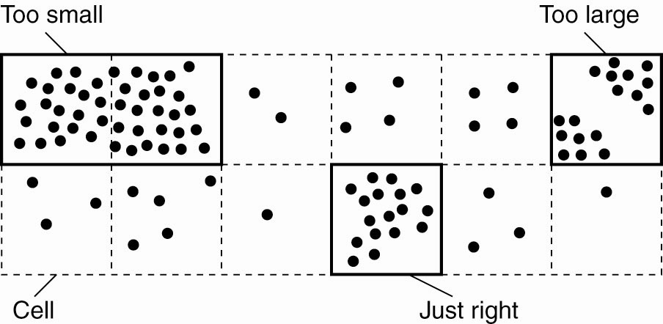
Replica-Server Placement
Choosing a proper cell size for server placement

Slide 46
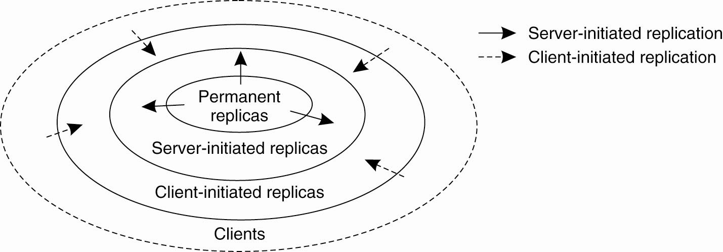
Content Replication and Placement
Regardless of which consistency model is chosen, we need to decide where, when and by whom copies of the data-store are to be placed.

Slide 47
Replica Placement Types
There are three types of replica:
Permanent replicas: tend to be small in number, organized as COWs (Clusters of Workstations) or mirrored systems.
Server-initiated replicas: used to enhance performance at the initiation of the owner of the data-store. Typically used by web hosting companies to geographically locate replicas close
to where they are needed most. (Often referred to
as “push caches”).
Client-initiated replicas: created as a result of client requests – think of browser caches. Works well assuming, of course, that the cached data does not
go stale too soon.

Slide 48
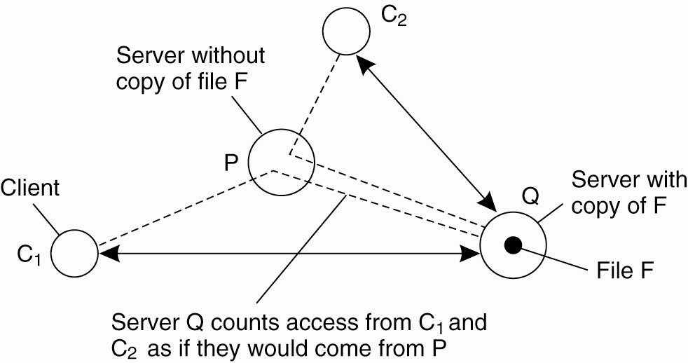
Server-Initiated Replicas
Counting access requests from different clients

Slide 49
Content Distribution
When a client initiates an update to a distributed data-store, what gets propagated?
There are three possibilities:
Propagate notification of the update to the other replicas – this is an “invalidation protocol” which indicates that the replica’s data is no longer up-to-date. Can work well when there’s many writes.
Transfer the data from one replica to another – works well when there’s many reads.
Propagate the update to the other replicas – this is “active replication”, and shifts the workload to each of the replicas upon an “initial write”.

Slide 50
Push vs. Pull Protocols
Another design issue relates to whether or not the updates are pushed or pulled?
Push-based/Server-based Approach: sent “automatically” by server, the client does not request the update. This approach is useful when a high degree of consistency is needed. Often used between permanent and server-initiated replicas.
Pull-based/Client-based Approach: used by client caches (e.g., browsers), updates are requested by the client from the server. No request, no update!

Slide 51
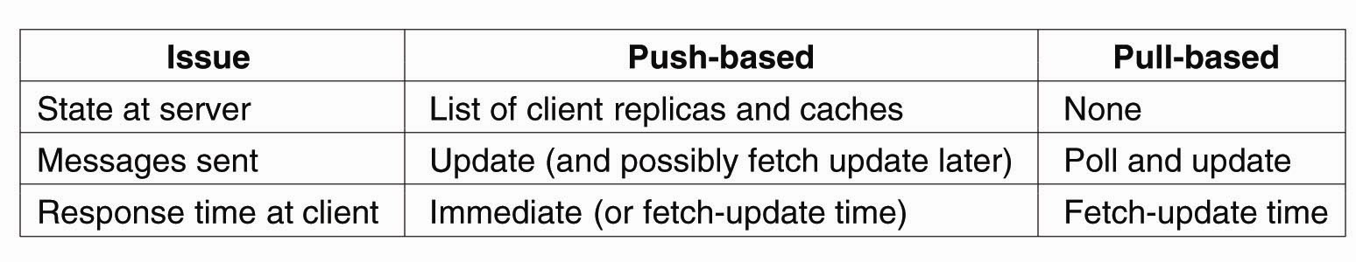
Pull versus Push Protocols
A comparison between push-based and pull-based protocols in the case of multiple-client, single-server systems

Slide 52
Hybrid Schemes
“Leases” – a promise from a server to push updates to a client for a period of time.
Once the lease expires, the client reverts to a pull-based approach (until another lease is issued).
Three kinds of leases:
  Age-based Leases
  Renewal-Frequency based Leases
  State-based Leases

Slide 53
Epidemic Protocols
This is an interesting class of protocols that can be used to implement Eventual Consistency (note: these protocols are used in Bayou).
The main concern is the propagation of updates to all the replicas in as few a number of messages as possible.
Of course, here we are spreading updates, not diseases!
With this “update propagation model”, the idea is to “infect” as many replicas as quickly as possible.

Slide 54
Epidemic Protocols: Terminology
Infective replica: a server that holds an update that can be spread to other replicas.
Susceptible replica: a yet to be updated server.
Removed replica: an updated server that will not (or cannot) spread the update to any other replicas.
The trick is to get all susceptible servers to either infective or removed states as quickly as possible without leaving any replicas out.

Slide 55
The Anti-Entropy Protocol
Entropy: “a measure of the degradation or disorganization of the universe”.
Server P picks Q at random and exchanges updates, using one of three approaches:
    P only pushes its own updates to Q
    P only pulls in new updates from Q
    P and Q send updates to each other
Sooner or later, all the servers in the system will be infected (updated). Works well.

Slide 56
The Gossiping Protocol
This variant is referred to as “gossiping” or “rumour spreading”, and works as follows:
  P has just been updated for item ‘x’.
  It immediately pushes the update of ‘x’ to Q.
  If Q already knows about ‘x’, P becomes disinterested in spreading any more updates (rumours) and is removed.
  Otherwise P gossips to another server, as does Q.
This approach is good, but can be shown not to guarantee the propagation of all updates to all servers. Oh dear.

Slide 57
The Best of Both Worlds
A mix of anti-entropy and gossiping is regarded as the best approach to rapidly infecting systems with updates.
However, what about removing data?
  Updates are easy, deletion is much, much harder!
  Under certain circumstances, after a deletion, an “old” reference to the deleted item may appear at some replica and cause the deleted item to be reactivated!
  One solution is to issue “Death Certificates” for data items – these are a special type of update.
  Only problem remaining is the eventual removal of “old” death certificates (with which timeouts can help).

Slide 58
Consistency Protocols
This is a specific implementation of a consistency model.
The most widely implemented models are:
  Sequential Consistency.
  Weak Consistency (with sync variables).
  Atomic Transactions.

Slide 59
Primary-Based Protocols
Each data item is associated with a “primary” replica.
The primary is responsible for coordinating writes to the data item.
There are two types of Primary-Based Protocol:
  Remote-Write
  Local-Write

Slide 60
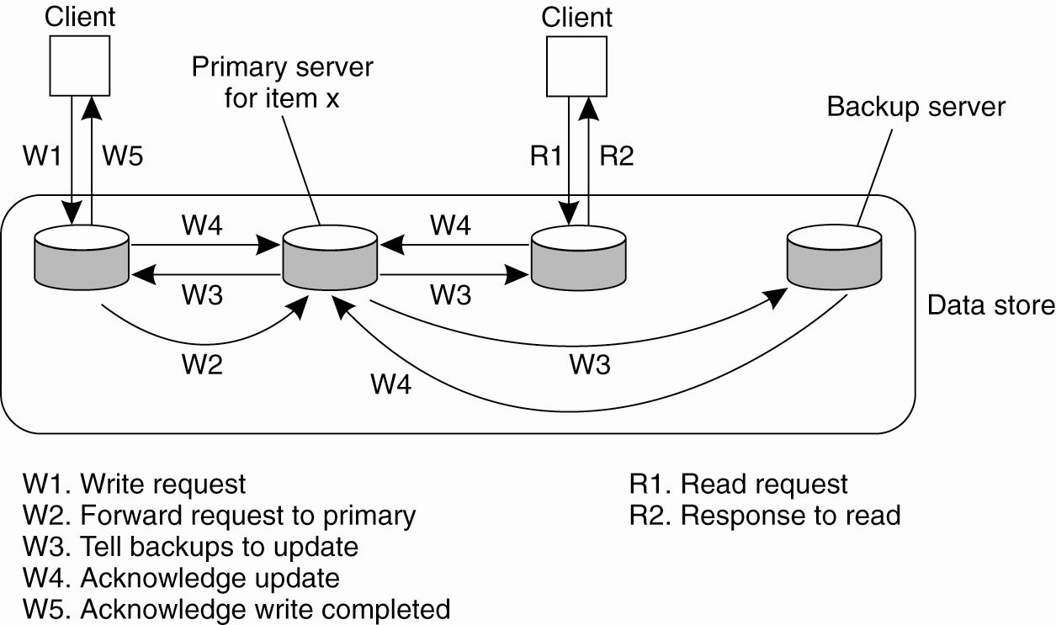
Remote-Write Protocols
The principle of a primary-backup protocol

Slide 61
The Bad and Good of Primary-Backup
Bad: Performance!
All of those writes can take a long time (especially when a “blocking write protocol” is used).
Using a non-blocking write protocol to handle the updates can lead to fault tolerant problems (which is our next topic).
Good: The benefit of this scheme is, as the primary is in control, all writes can be sent to each backup replica IN THE SAME ORDER, making it easy to implement sequential consistency.

Slide 62
Local-Write Protocols
In this protocol, a single copy of the data item
is still maintained.
Upon a write, the data item gets transferred to the replica that is writing.
That is, the status of primary for a data item is transferable.
This is also called a “fully migrating approach”.

Slide 63
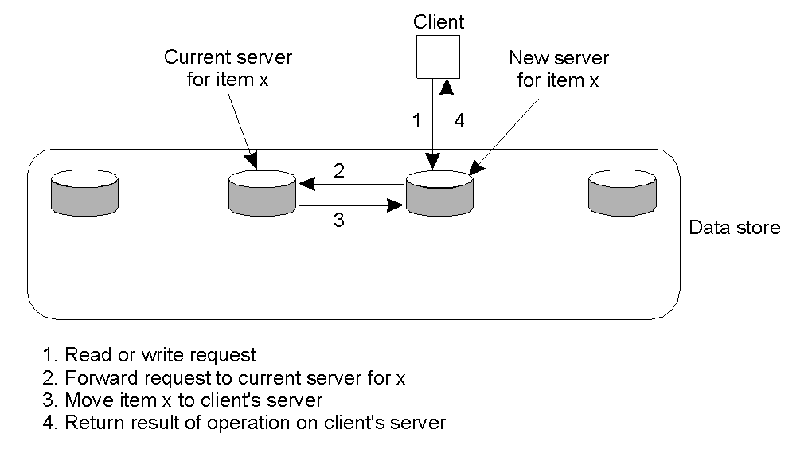
Local-Write Protocols Example
Primary-based local-write protocol in which a single copy is migrated between processes (prior to the read/write).

Slide 64
Local-Write Issues
The big question to be answered by any process about to read from or write to the data item is:
  “Where is the data item right now?”
It is possible to use some of the dynamic naming technologies studied earlier in this course, but scaling quickly becomes an issue.
Processes can spend more time actually locating a data item than using it!

Slide 65
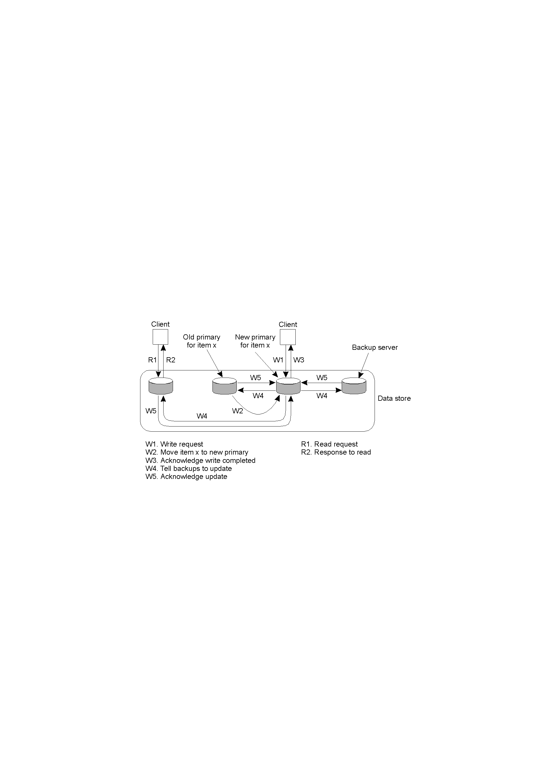
Local-Write Protocols
Primary-backup protocol in which the primary migrates to the process wanting to perform an update, then updates the backups. Consequently, reads are much more efficient.

Slide 66
Replicated-Write Protocols
With these protocols, writes can be carried out at any replica.
Another name might be: “Distributed-Write Protocols”
There are two types:
  Active Replication
  Majority Voting (Quorums)

Slide 67
Active Replication
A special process carries out the update operations at each replica.
Lamport’s timestamps can be used to achieve total ordering, but this does not scale well within distributed systems.
An alternative/variation is to use a sequencer, which is a process that assigns a unique ID# to each update, which is then propagated to all replicas.
This can lead to another problem: replicated invocations.

Slide 68
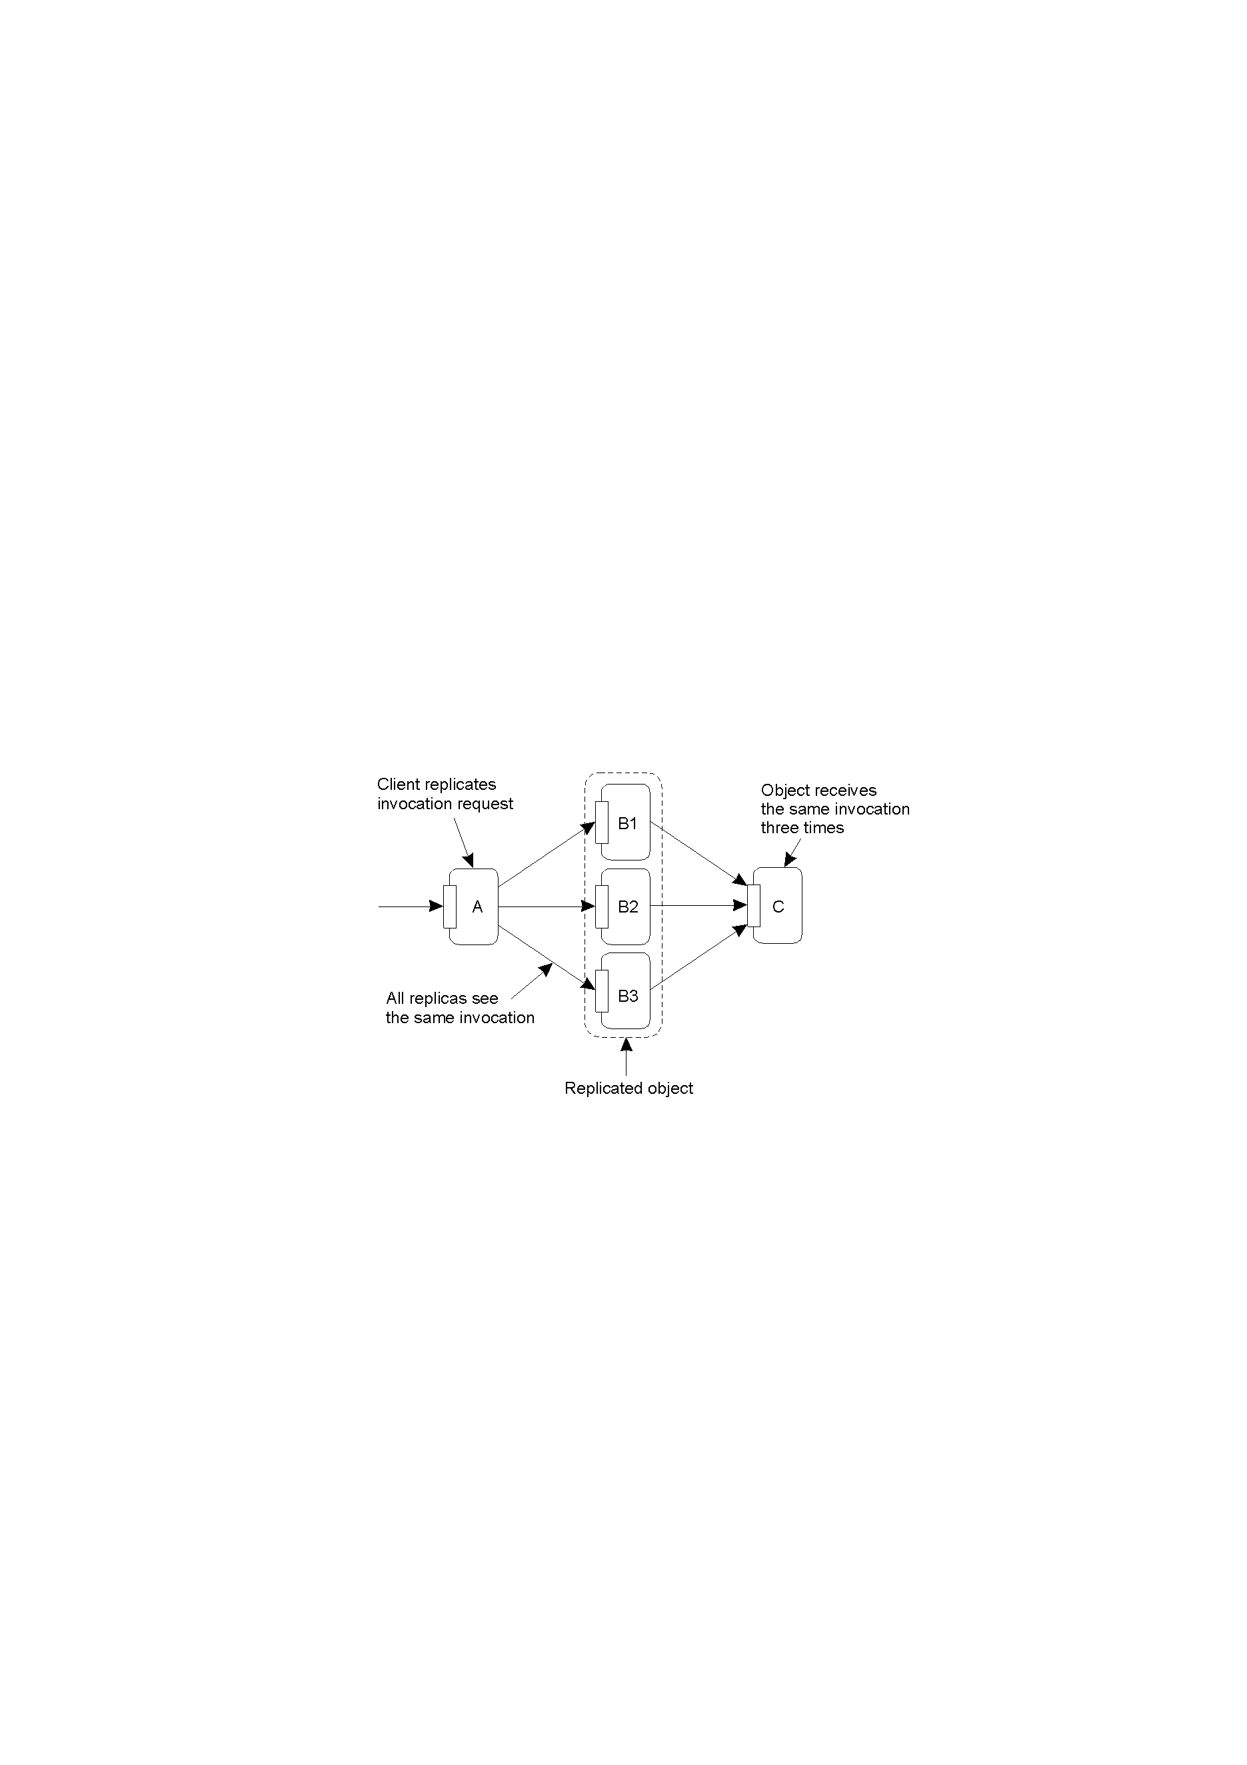
Replicated Invocations: The Problem
The problem of replicated invocations – ‘B’ is a replicated object (which itself calls ‘C’). When ‘A’ calls ‘B’, how do we ensure ‘C’ isn’t invoked three times?

Slide 69
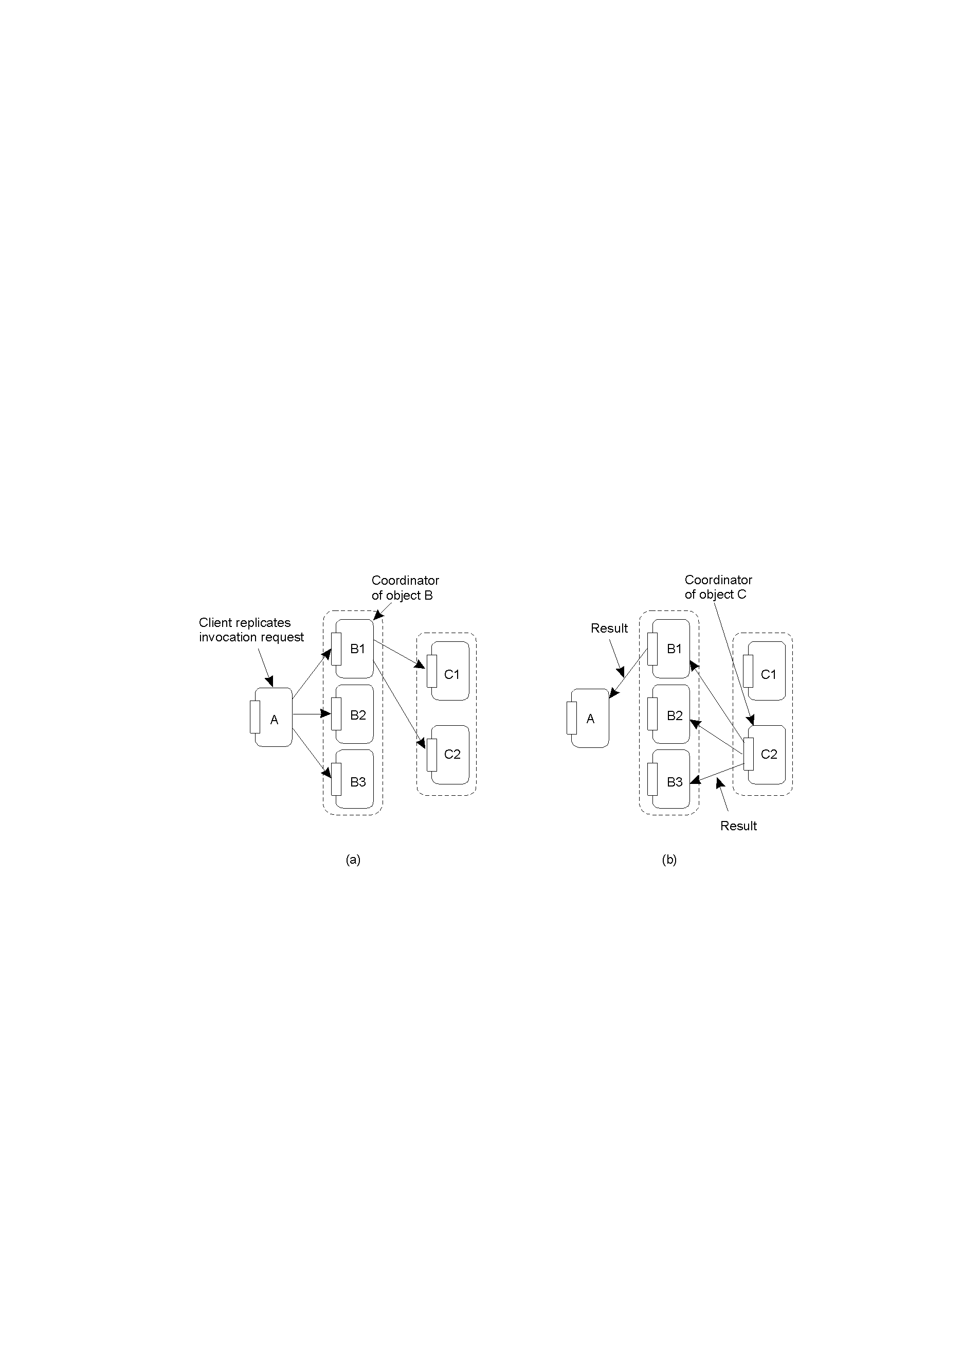
Replicated Invocations: Solutions
Using a coordinator for ‘B’, which is responsible for forwarding an invocation request from the replicated object to ‘C’.
Returning results from ‘C’ using the same idea: a coordinator is responsible for returning the result to all ‘B’s. Note the single result returned to ‘A’.

Slide 70
Quorum-Based Protocols
Clients must request and acquire permissions from multiple replicas before either reading/writing a replicated data item.
Consider this example:
  A file is replicated within a distributed file system.
  To update a file, a process must get approval from a majority of the replicas to perform a write. The replicas need to agree to also perform the write.
  After the update, the file has a new version # associated with it (and it is set at all the updated replicas).
  To read, a process contacts a majority of the replicas and asks for the version # of the files. If the version # is the same, then the file must be the most recent version, and the read can proceed.

Slide 71
Quorum Protocols: Generalisation
N_{R} + N_{W} > N
N_{W} > N/2

Slide 72
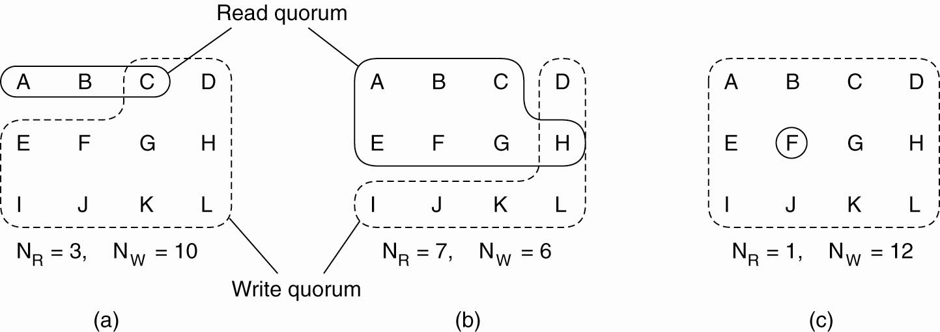
Quorum-Based Protocols
Three examples of the voting algorithm:
(a) A correct choice of read and write set.
(b) A choice that may lead to write-write conflicts. (c) A correct choice, known as ROWA (read one, write all).

